Slide 1

Smart Courier Tracking and Delivery
Route Management Platform
GUIDED BY :
DR . SIVASANKAR
PRESENTED BY :
HEMA PRIYA T
SUBIKSHA U
BAGYA VENKATESH

Slide 2


Problem Background
.
The courier industry is growing rapidly due to the rise of e-commerce and online shopping.
Customers expect real-time shipment tracking and faster deliveries.
Many courier services still rely on manual route planning and outdated tracking systems.
Delivery delays, inefficient routes, and poor communication reduce customer satisfaction.
Companies need a smart platform that provides shipment visibility and optimized delivery planning.

Slide 3
Problem Statement
Lack of real-time shipment tracking.
Inefficient delivery route planning increases travel time and fuel costs.
Customers receive limited updates about shipment status.
Delivery managers face difficulty monitoring drivers and deliveries.
Existing systems cannot efficiently handle large-scale courier operations.

Slide 4
Objectives
Develop a centralized courier management platform.
Enable real-time shipment tracking.
Optimize delivery routes using intelligent algorithms.
Reduce delivery time and transportation costs.
Improve customer satisfaction through timely notifications.
Provide dashboards for monitoring delivery performance.

Slide 5
Existing vs Proposed System
Existing System | Proposed System
Manual shipment updates | Real-time shipment tracking
Fixed delivery routes | AI-based optimized routes.
Limited customer visibility | Live shipment status
Higher fuel consumption | Reduced travel distance

Slide 6
Requirements
Hardware Requirements
Intel Core i3/i5 Processor
8 GB RAM
256 GB SSD
GPS-enabled mobile device
Internet connection
Software Requirements
Operating System: Windows/Linux
Frontend: HTML, CSS, JavaScript
Backend: Python (Flask/Django) or Node.js
Database: MySQL/PostgreSQL
Google Maps API / OpenStreetMap
Web Browser

Slide 7
Planning
Requirement Analysis
Gather user requirements and identify system objectives.
System Design
Design the database, user interface, and overall system architecture.
Module Development
Develop the Shipment Management, Route Optimization, and Delivery Dashboard modules.
Testing & Integration
Integrate all modules, test functionality, fix bugs, and optimize performance.
Deployment & Maintenance
Deploy the platform, monitor performance, provide updates, and maintain the system.

Slide 8
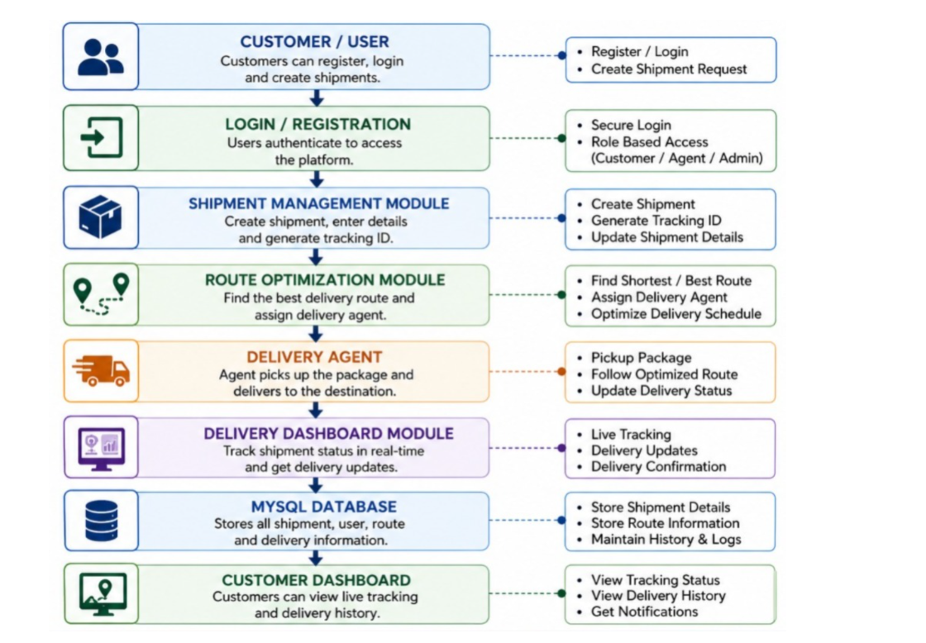
SYSTEM ARCHITECTURE

Slide 9
Expected Outcomes
Real-time shipment visibility.
Reduced delivery time.
Optimized delivery routes.
Lower fuel consumption.
Improved customer satisfaction.
Better delivery planning.
Accurate delivery reports and analytics.

Slide 10
THANK YOU

